Slide 1
CS4306-Core Course Project
IoT-based tracking and monitoring to optimize long-haul commercial truck usage for postal/logistics
Team Members : AKASH KUMAR GOUDA – 24CS0038
AADHISH S – 24CS0012

Slide 2

Optimizing Long-Haul Truck Usage: An IoT-Driven Approach
This presentation outlines an innovative approach to revolutionize postal and logistics operations through IoT-driven real-time data. We aim to enhance efficiency, significantly reduce costs, and improve service delivery within the Indian freight logistics market, valued at over $800 billion annually.

Slide 3

Problem Statement:
Nowadays, every modern vehicle has its own sensors and in vehicle communication module for sensing data accurately, processing and making decisions. The modern developments and changes in internet of things (IoT) and cloud computing have been providing a capable prospect to resolve the increasing modern vehicle transportation problems, for predicting the traffic congestion, finding the shortest route, and vehicle security and safety. As a result, many investigators focus on intelligent transportation system (ITS) developed to improving driver’s safety, security, and convenience .
The need for efficient goods transportation system such as real time tracking, finding the accident location and reducing financial fuel loss of trucks is rapidly increased. Two major factors that leads to financial loss for truck owners are time and cost. Time is important for goods delivery, failing which may lead to financial loss to owner as well as customer. The truck owner needs to know the accurate arrival time and destination time of the particular truck to a particular station which allows effective management and scheduling of truck for next delivery.
This can be overcome by using the real time tracking vehicle system . Second one is cost, in recent days fuel cost is raising constantly. Fuel cost is major impact on truck or any vehicle transportation. Fuel monitoring are main problems that most of truck companies looking to resolve. Remote monitoring and data collection systems are useful and effective tools to collect information from fuel storage tanks. The number of accidents is shooting upward daily along with the rising safety concerns while travelling. Many people life were lost every ever due to careless of drivers and others. Accident preventive mechanism prevents the possible situation that may lead to accident.

Slide 4

Aim & Scope
1
Aim
To develop an IoT-based truck monitoring system that enhances operational efficiency, safety, and cost-effectiveness in the trucking industry by enabling:
Real-time location tracking
Fuel level monitoring and leakage detection
Accident detection and alerting
2
Scope
Real-Time GPS Tracking
Use of GPS modules to continuously monitor the truck's location.
Location data is transmitted to the cloud and displayed on a live dashboard.
Fuel Monitoring & Leakage Detection
Integration of fuel level sensors to monitor usage patterns.
Alerts triggered for abnormal drops in fuel level, indicating leakage or theft.
Accident Detection System
Utilization of accelerometers and gyroscopes to detect sudden motion changes.
Immediate alerts sent in case of possible accidents or collision risks.
Cloud Integration
Data sent to platforms like Firebase, AWS IoT, or ThingSpeak for storage, analysis, and visualization.
Historical data used for analytics, maintenance planning, and efficiency tracking.
Web Dashboard
User-friendly interface for fleet managers to monitor real-time data.
Push/email/SMS notifications in case of emergencies or anomalies.

Slide 5
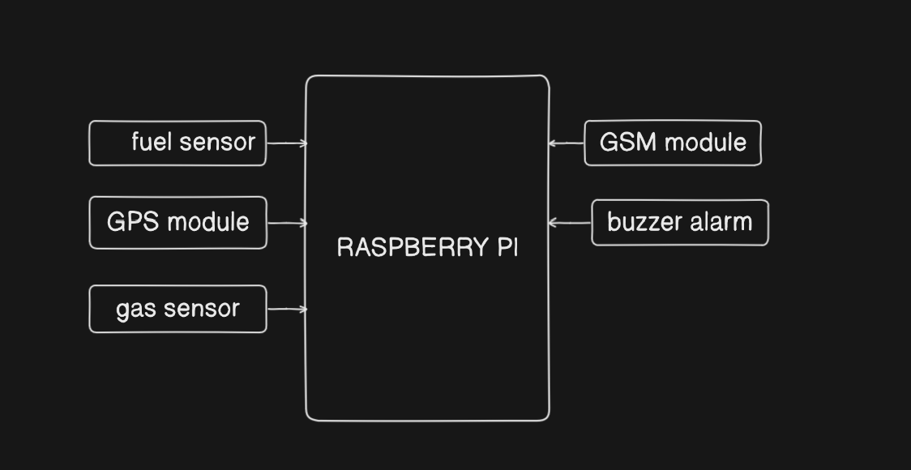
Proposed System Architecture (Block Diagram)

Slide 6
Implementation Setup
HARDWARE SETUP :
RASPBERRY PI 3
GPS MODULE (NEO-6M)
FUEL LEVEL SENSOR
GAS SENSOR
GSM MODULE
BUZZER ALARM
SOFTWARE SETUP:
PYTHON : Programming language for sensor interfacing and cloud communication
Firebase : Cloud platform for real-time data storage and visualization
SMTP Library : Sends alert emails on accidents or leaks
Google Maps API : Displays real-time truck location on a web dashboard
React : For building custom dashboards on web

Slide 7
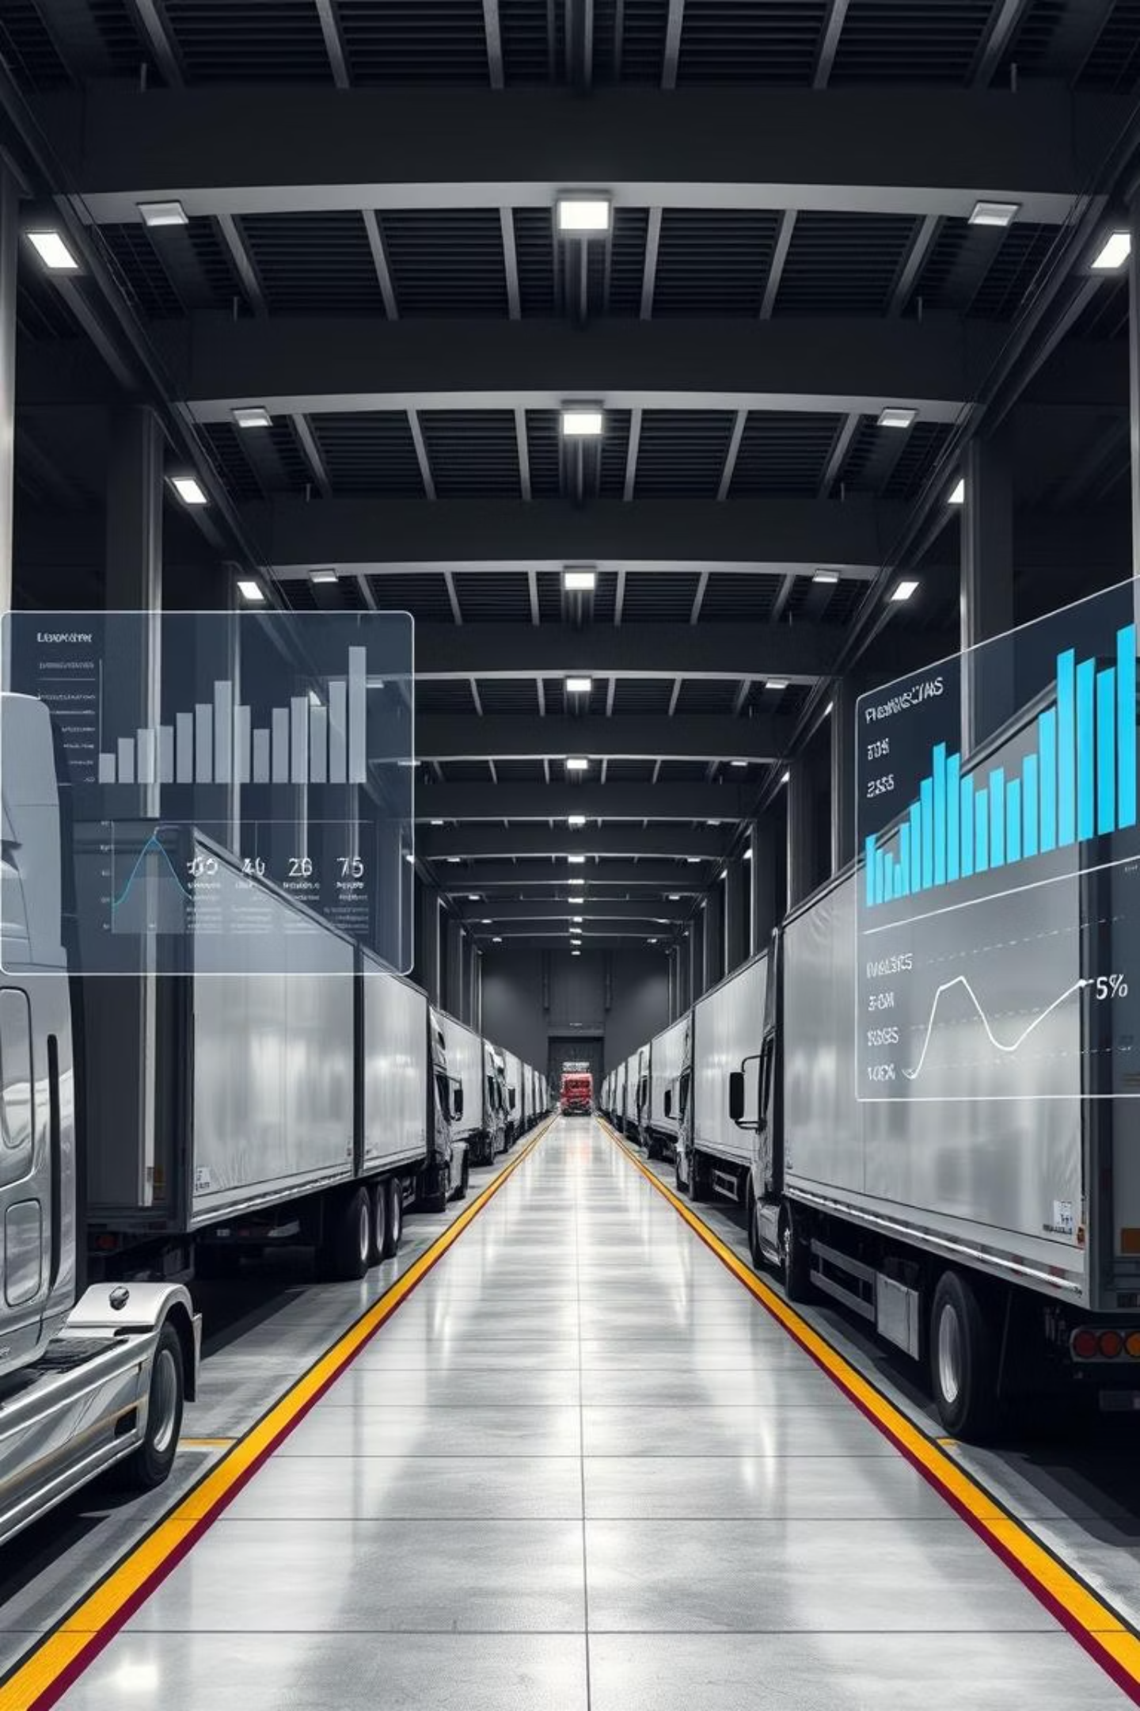
Conclusion: Driving Strategic Advantage
This IoT-driven solution is projected to yield a strong ROI within 18-24 months, primarily through significant savings in fuel, maintenance, and labor costs.
Enhanced Customer Satisfaction: Improved delivery predictability and cargo safety will lead to higher client retention and satisfaction.
Scalable Solution: The system is designed for adaptability, allowing seamless expansion to growing fleet sizes and evolving operational demands.
Industry Leadership: Implementing this advanced technology positions the company as a pioneer in data-driven, efficient logistics operations.

